Slide 1














Honesty: Truthfulness, Trustworthiness, Academic and Research
Presented By Taha Jamali And
Shaheryar Shafiq and Minhaj Khan

Slide 2

Introduction to Honesty
Good Morning, everyone. Today, We will be discussing a crucial topic: honesty, especially in academic and research work. Honesty plays a big role in building trust and integrity in everything we do. Whether in personal relationships, business, or academia, it ensures that others can rely on us. In today’s session, we will focus on how truthfulness and trustworthiness are essential to academic and research integrity.

Slide 3
Why Honesty Matters in Academia
Honesty is not just a personal virtue, it’s the foundation of ethical behavior in academic and research settings. In research, when we present our work truthfully, we maintain trust among colleagues, institutions, and the public. Without honesty, research loses credibility. In this presentation, we will look at a case study that explores what happens when honesty is compromised, and we’ll discuss why trust and truthfulness are vital for academic and research integrity

Slide 4
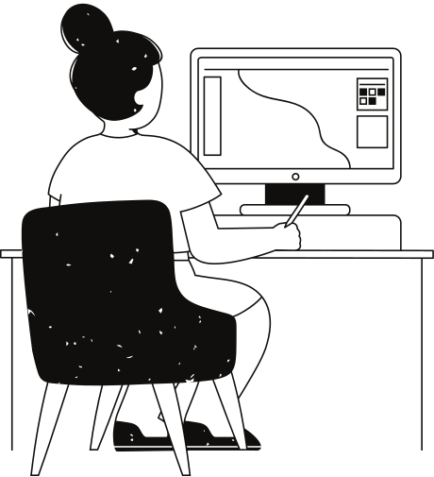
Case Study – Dr. Maria Hassan
Let’s look at the case of Dr. Maria Hassan, a respected researcher known for her breakthrough in developing a new drug for a rare disease. However, during a routine check, her assistant found that some of the published results did not match the raw data. This raises an ethical dilemma: Should the assistant report the discrepancies and risk Dr. Hassan’s reputation, or stay silent, assuming these differences are minor

Slide 5
Truthfulness and Its Impact
The first aspect of honesty is truthfulness. Truthfulness means presenting information as it is, without omitting or changing details. In Dr. Hassan’s case, whether the discrepancies were intentional or accidental, not reporting accurate data damages the truthfulness of the research. This could lead to incorrect conclusions, putting the validity of the entire study at risk and potentially misleading others in the field who rely on her findings

Slide 6
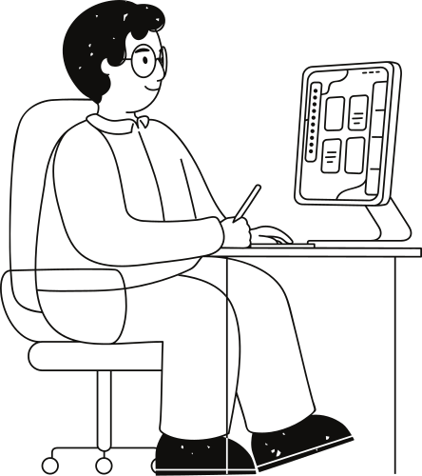
Trustworthiness and Integrity
Trustworthiness goes hand in hand with truthfulness. If researchers are not trustworthy, their work becomes unreliable. In the case of Dr. Hassan, her trustworthiness came into question when her assistant found the errors. Even if the mistakes weren’t intentional, ignoring them could erode trust in her and her institution. Integrity means consistently following ethical standards, especially in reporting data, and this case shows how quickly that trust can be broken

Slide 7
Resolution
In the end, the assistant reported the discrepancies to the ethics committee. After investigating, they found that Dr. Hassan had not intentionally falsified data, but she had failed to follow proper procedures. She was allowed to correct her data and republish her findings. Although this hurt her reputation at first, being transparent helped her rebuild trust.

Slide 8
Lessons Learned
The lesson here is that honesty, even after a mistake, is crucial. Upholding truthfulness, trustworthiness, and integrity in research protects the credibility of the work. Errors can happen, but addressing them transparently helps preserve the trust placed in academic and scientific research. This case shows that ethical standards are not just guidelines—they are essential for maintaining trust and advancing knowledge

Slide 9
Thank you very much!

